Slide 1
Machine learning Eugene munyaneza 2024/HD05/21936U

Slide 2
AGENDA
Introduction
Analysis
Data wrangling
Model Training

Slide 3
Introduction
Breast cancer risk estimation for Cuban women
My data is from BCSC Hispanic dataset.
We shall be examining medical data of 1,697 cases of breast cancer diagnosis in Cuban women.
Aim? Find if given the data we can predict the occurrence of breast cancer.

Slide 4
introduction
Data composition
Shape; 1697 records and 23 features.
Features were of many data types; strings, numeric etc.
Zero duplicate values.
1,160 cases had cancer compared to 537 who didn’t
Notes:
Risk factor: Description - Data type (Values)
age: Patient's age - Quantitative ( 20 - 90)
menarche: Age of menarche - Quantitative ( 8 - 17)
menopause: Age of menopause - Quantitative ( 0, 30 - 60)
agefirst: Age at first successful delivery - Quantitative ( 0, 9 - 46)
children: Number of children born alive - ( 0 - 6)
breastfeeding: Time breastfed in months - Quantitative ( 0 - 72(months))
nrelbc: Number of first-degree relatives with breast cancer - Quantitative ( 0 - 2)
biopsies: Number of breast biopsies - Quantitative ( 0 - 5)
hyperplasia: Atypical hyperplasia - Qualitative ( no, yes)
race: Race - Quantitative ( white, mixed, black)
year:
imc:
weight: Patients weight at screening - Quantitative - Kgs
exercise: Weekly physical activity - Quantitative ( 0 - 7)
alcohol: Alcohol consumption - Qualitative ( no, yes)
tobacco: Tobacco consumption - Qualitative ( no, yes)
allergies: Number of allergies suffered - Qualitative ( no, dermatitis, laryngitis, medications, other)
emotional:
depressive: Whether a patient is depressed or not - Qaulitative (yes, no)
histologicalclass:
birads: Breast Imaging-Reporting and Data System (BI-RADS) (0,1,2,3,4,5,6 broken into A,B and C)
cancer: Breast cancer diagnosis - Qualitative ( no, yes)

Slide 5
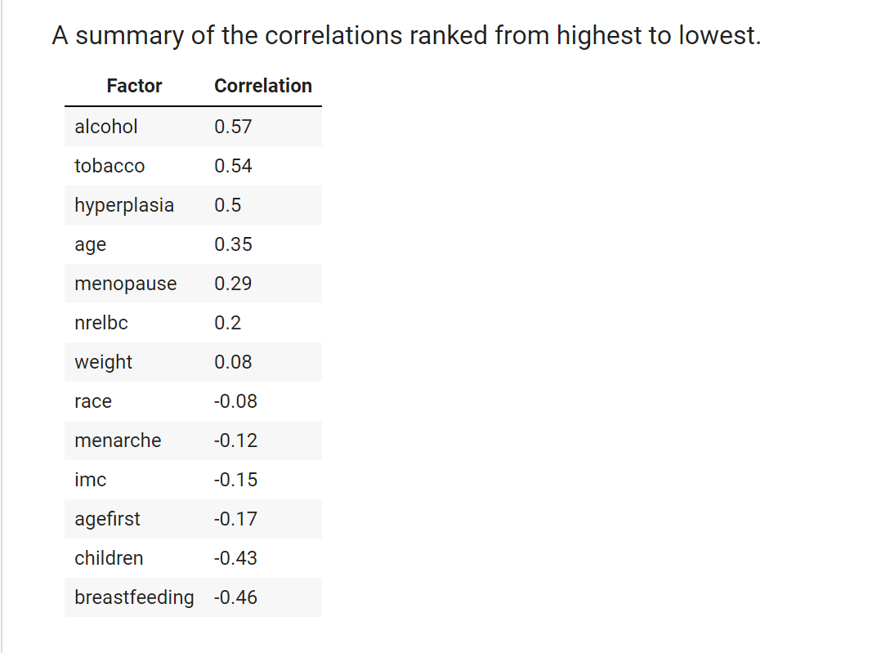
Data analysis
Univariate analysis
After we have cleaned all our data the next step is to find what variables have a strong correlation to cause cancer.
Notes:
Missing values.
biopsies 1
imc 7
weight 10
Only one biopsie is missing, we can fill it with the 50% percentile value.
Only 7 imc are missing, we can fill it with the mean.
Only 10 weights are missing, we can fill it with the mean.
Label encoding.
Variables with a binary ch
Cleaning exercise per week, this will be replaced by number of days in a week exercised. From 0 to 7.
Cleaning children, where it says 5+ replace with 6.
Cleaning breastfeeding, where it says No replace with 0, the rest is number of months breast fed.
Cleaning nrelbc (Number of first-degree relatives with breast cancer).
We can see that the data in this column is split by a forward slash, therefore each time we encounter this we count another family member.
Fixing outliers
To clearly view the plots, we can group elemts that have similar minimum and maximum values.
Therefore, those we are going to have the following ranges.
0 - 5: nrelbc, biopsies, hyperplasia, race, alcohol, tobaco.
5 - 20: menarche.
80 - 100: age, imc.
above 100: weight.
Outliers weren’t removed since I wanted to see their effects on the model.

Slide 6
Data wrangling
Steps involved
Label encoding.
Filtering outliers
Missing values.
Notes:
Missing values.
biopsies 1
imc 7
weight 10
Only one biopsie is missing, we can fill it with the 50% percentile value.
Only 7 imc are missing, we can fill it with the mean.
Only 10 weights are missing, we can fill it with the mean.
Label encoding.
Variables with a binary ch
Cleaning exercise per week, this will be replaced by number of days in a week exercised. From 0 to 7.
Cleaning children, where it says 5+ replace with 6.
Cleaning breastfeeding, where it says No replace with 0, the rest is number of months breast fed.
Cleaning nrelbc (Number of first-degree relatives with breast cancer).
We can see that the data in this column is split by a forward slash, therefore each time we encounter this we count another family member.
Fixing outliers
To clearly view the plots, we can group elemts that have similar minimum and maximum values.
Therefore, those we are going to have the following ranges.
0 - 5: nrelbc, biopsies, hyperplasia, race, alcohol, tobaco.
5 - 20: menarche.
80 - 100: age, imc.
above 100: weight.
Outliers weren’t removed since I wanted to see their effects on the model.

Slide 7
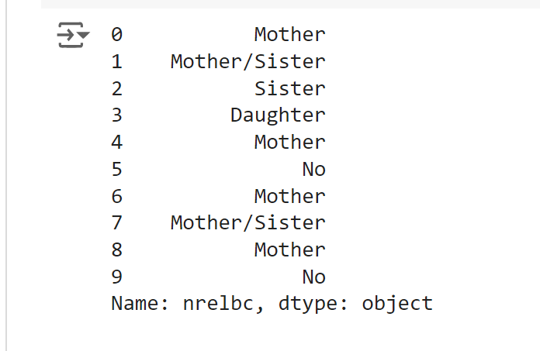
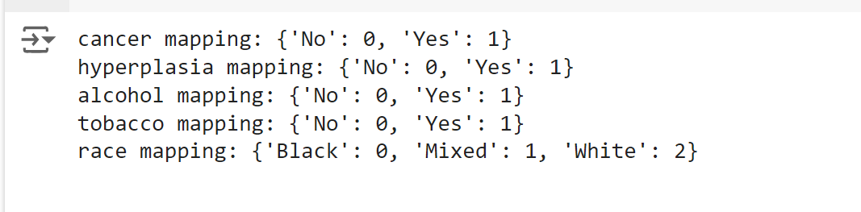
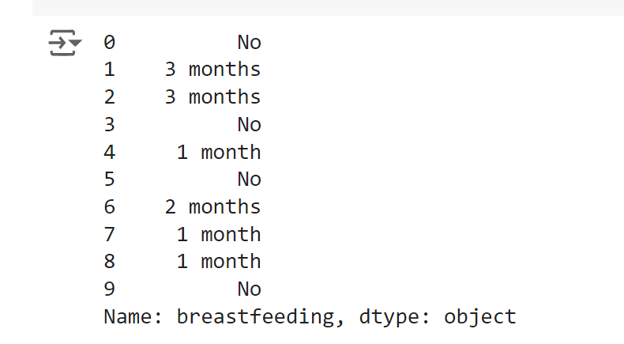
Data wrangling
Label Encoding
Notes:
Missing values.
biopsies 1
imc 7
weight 10
Only one biopsie is missing, we can fill it with the 50% percentile value.
Only 7 imc are missing, we can fill it with the mean.
Only 10 weights are missing, we can fill it with the mean.
Label encoding.
Variables with a binary ch
Cleaning exercise per week, this will be replaced by number of days in a week exercised. From 0 to 7.
Cleaning children, where it says 5+ replace with 6.
Cleaning breastfeeding, where it says No replace with 0, the rest is number of months breast fed.
Cleaning nrelbc (Number of first-degree relatives with breast cancer).
We can see that the data in this column is split by a forward slash, therefore each time we encounter this we count another family member.
Fixing outliers
To clearly view the plots, we can group elemts that have similar minimum and maximum values.
Therefore, those we are going to have the following ranges.
0 - 5: nrelbc, biopsies, hyperplasia, race, alcohol, tobaco.
5 - 20: menarche.
80 - 100: age, imc.
above 100: weight.
Outliers weren’t removed since I wanted to see their effects on the model.

Slide 8
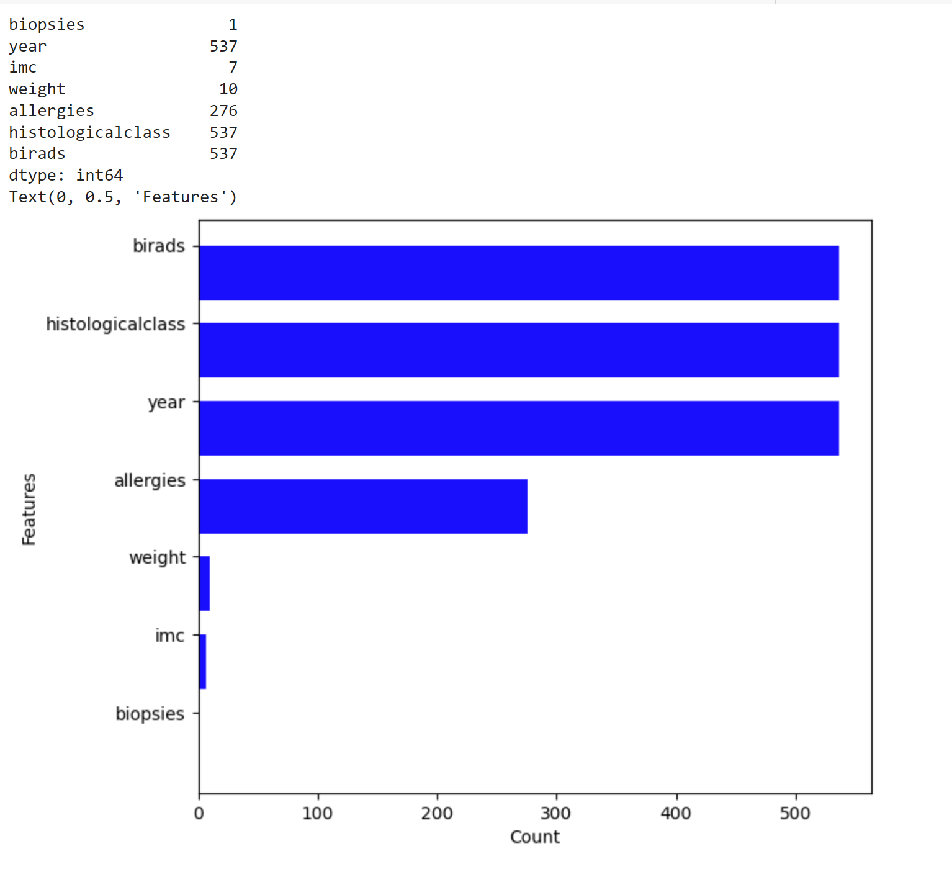
Data wrangling
Missing Values
Notes:
Missing values.
biopsies 1
imc 7
weight 10
Only one biopsie is missing, we can fill it with the 50% percentile value.
Only 7 imc are missing, we can fill it with the mean.
Only 10 weights are missing, we can fill it with the mean.
Label encoding.
Variables with a binary ch
Cleaning exercise per week, this will be replaced by number of days in a week exercised. From 0 to 7.
Cleaning children, where it says 5+ replace with 6.
Cleaning breastfeeding, where it says No replace with 0, the rest is number of months breast fed.
Cleaning nrelbc (Number of first-degree relatives with breast cancer).
We can see that the data in this column is split by a forward slash, therefore each time we encounter this we count another family member.
Fixing outliers
To clearly view the plots, we can group elemts that have similar minimum and maximum values.
Therefore, those we are going to have the following ranges.
0 - 5: nrelbc, biopsies, hyperplasia, race, alcohol, tobaco.
5 - 20: menarche.
80 - 100: age, imc.
above 100: weight.
Outliers weren’t removed since I wanted to see their effects on the model.

Slide 9
Model training
Classification problem
Decision tree.
Random forest.

Slide 10
Decision tree
Model training.
Model visualization.
Feature importance.
ROC curve
Confusion matrix?

Slide 11
Random forest
Model training.
Feature importance.
ROC curve
Confusion matrix?

Slide 12
Pending
MLflow.
Fine tuning the model, like finding the effect of outliers, tree pruning etc.
Working on feedback.

Slide 13
THANK YOU
Eugene Munyaneza
2024/HD05/21936U

